Slide 1


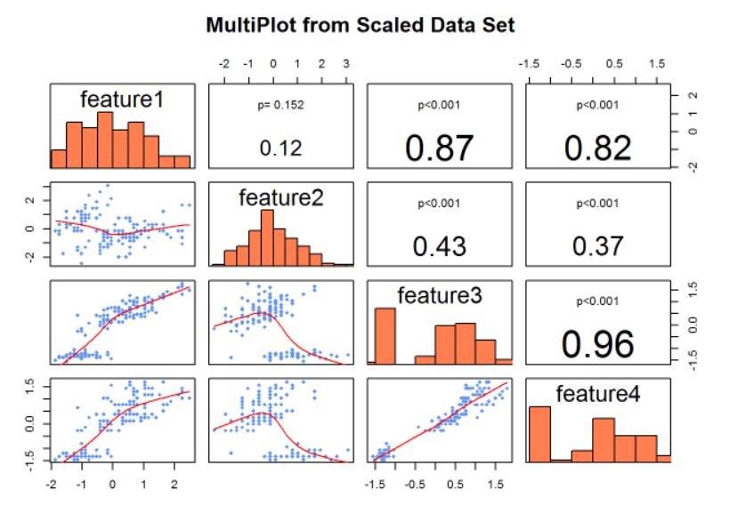

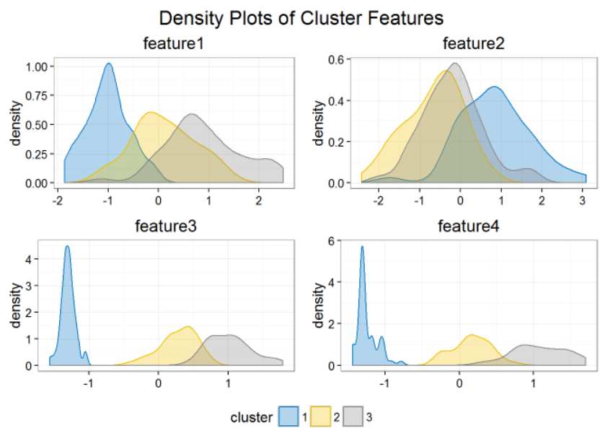
Introduction to R
Presenter:
Andy Lathrop, Principal Consultant
www.blue-granite.com
A link to these slides and additional resources will be sent following the presentation

Slide 2

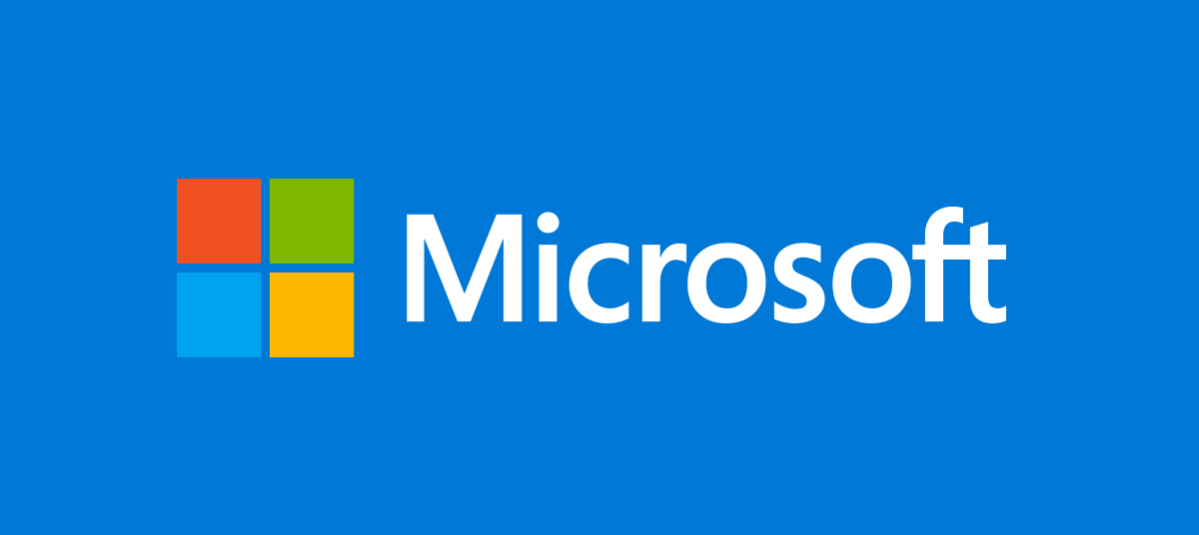


Overview
Objectives:
Introduction to the R platform
Business value of enterprise-class R
Demonstration of R in multiple environments
Next steps
Agenda (40-45 minutes):
Introduction of key organizations and technologies (10 min)
Value of advanced analytics (5 min)
Demonstration; R in action (15 min)
Local
AzureML
SQL2016
HDInsight
PowerBI
Getting started (5 min)
Q&A (5-10 min)

Slide 3
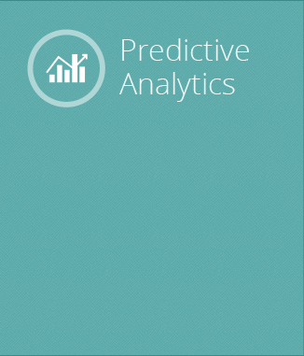
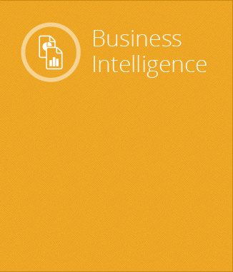
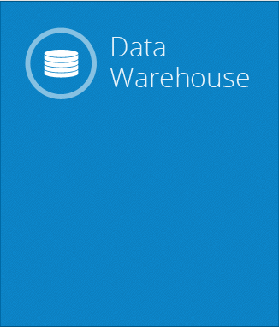
About BlueGranite
Business Insights. Delivered. Founded in 1996, BlueGranite partners with Microsoft to deploy data warehousing, business intelligence, and advanced analytic solutions.
Solve challenging problems using mathematical models to prescribe actions and maximize business objectives.
Help business users and decision makers understand past performance through visualizations, dashboards and automated reporting.
Enable the business to store and analyze large volumes of data with optimized systems that can scale quickly to meet demand.

Slide 4
About Microsoft R
Brief history of Microsoft R capabilities
Revolution Analytics brought commercially supported, high performance computing to R, overcoming many obstacles for enterprise applications using large data sets.
Revolution Analytics acquired by Microsoft in 2015.
Microsoft is the highest rated vendor in both Business Intelligence and Advanced Analytics for Completeness of Vision (Gartner 2016)
“…this is about more than just R; it's about Microsoft's very identity. Microsoft has decided -- and I think rightly so -- that the next era of computing, while enabled by the cloud, will feature data-driven intelligence; in platforms, in applications and in devices.” – ZDNet, “Microsoft's R Strategy”, May 2016
Notes:
Revolution took the R language, which was a client-side, memory-bound technology, and it made it server-based and multi-threaded. As a second act, Revolution built a distributed version of the product that could run in clustered/grid environments, so it could take on Big Data workloads and avoid sampling.
http://www.zdnet.com/article/microsofts-r-strategy/

Slide 5
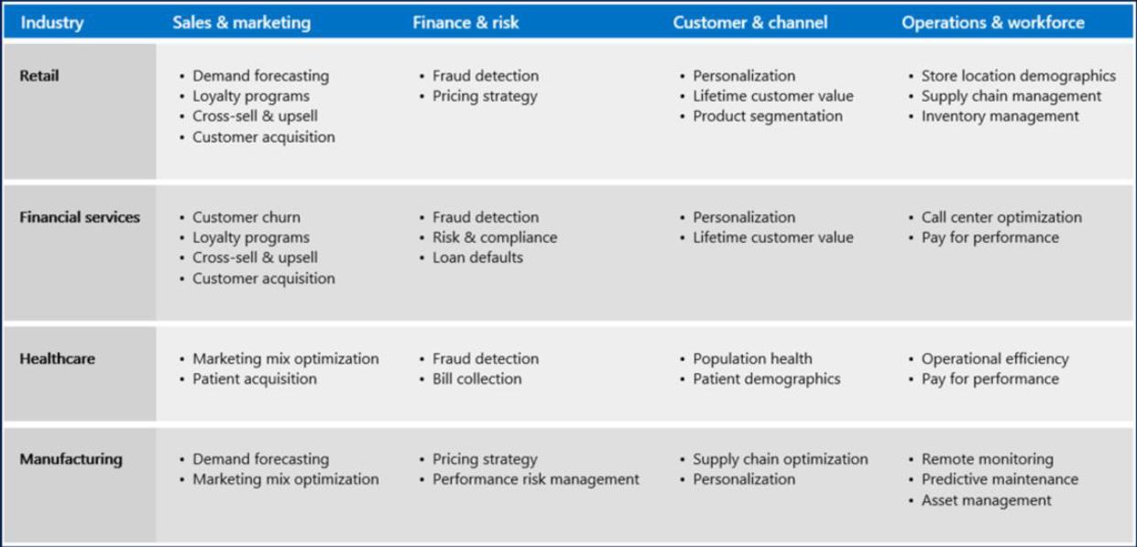
Business Value of Advanced Analytics: Key Solution Areas
Buzzwords:
Customer Analytics
Predictive Maintenance
Fraud Detection
Demand Forecasting
Price Optimization
Customer Segmentation
Campaign Analytics
https://gallery.cortanaintelligence.com/

Slide 6
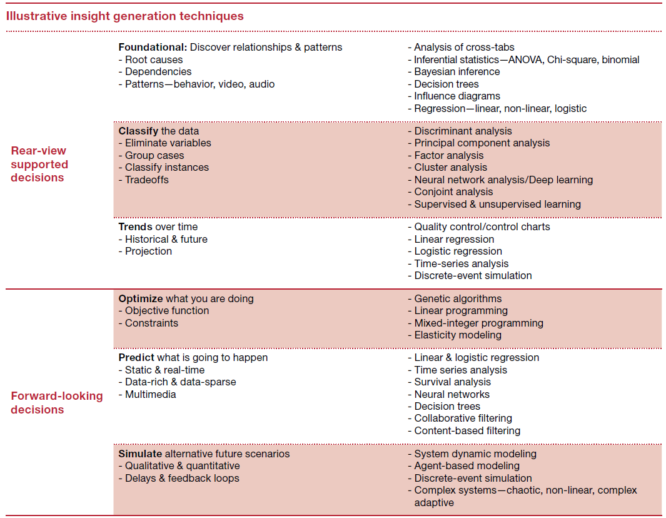
Business Value of Advanced Analytics: Key Analytic Capabilities
Buzzwords:
Predictive Analytics
Machine Learning
Forecasting
Regression
Data Mining
Clustering
Segmentation
Optimization
PWC: Data and Analytics: Creating or Destroying Shareholder Value
https://www.pwc.com/us/en/analytics/publications/assets/pwc-data-analytics-creating-or-destroying-shareholder-value.pdf

Slide 7
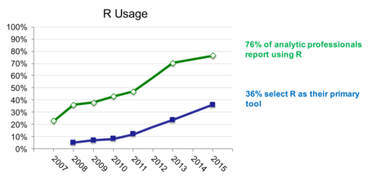
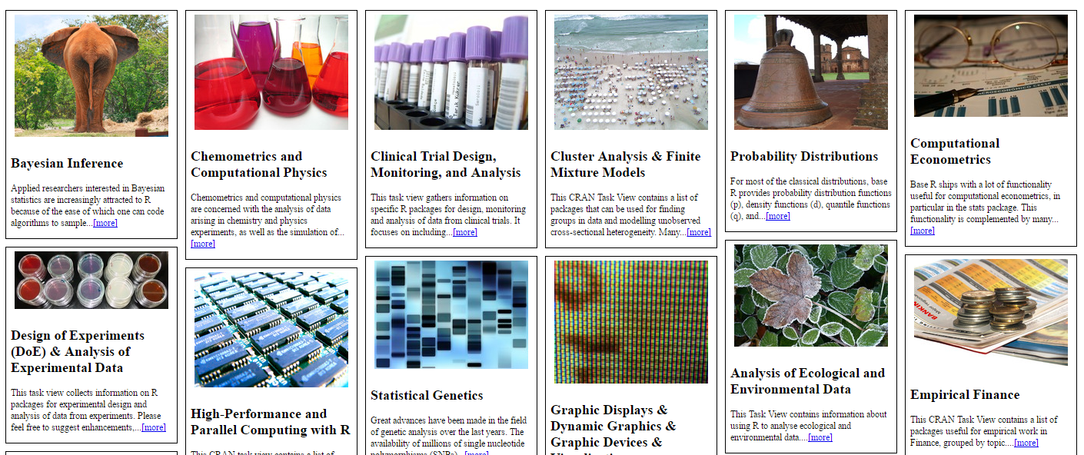
R: a freely available language and environment for statistical computing and graphics
1993: Created by Ross Ihaka and Robert Gentlemen in Auckland, NZ as an open-source implementation of the S programming language
Most widely used data analysis software
#1 for data science; #6 general purpose (IEEE Spectrum Rankings)
Common programming language of analytics and statistical computing
Unique and immersive data visualizations
Open-source, extensible, scalable library of 7500+ add-on packages; community of millions of users
R Popularity is Growing!
CRAN Packages

Slide 8
Free (cran.r-project.org)
Highly extensible
Focused on statistics and machine learning
Transparent and reproducible
Single-threaded
Data stored in memory

Slide 9
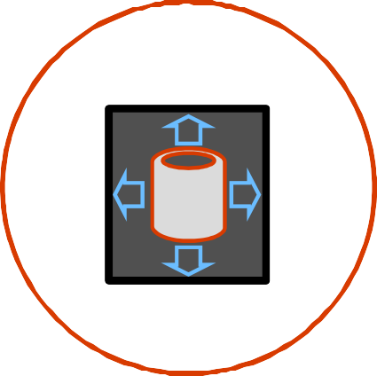



Challenges posed by open source R
?
?
Limited Data Scale
Inadequate Modeling Performance
Lack of Commercial Support
Complex Deployment Processes

Slide 10




Community
Commercial
SQL Server
R Open
R Services
R Server
Windows
Linux
Hadoop
Teradata
Spark

Slide 11

Introduction to Microsoft R Open (MRO)
MICROSOFT R OPEN: About
Enhanced open-source (CRAN) R distribution
100% compatible with all R-related software; CRAN packages, RStudio, and third-party R integrations
Faster performance with multi-threaded math libraries
CRAN “Time Machine” for reproducibility
Available for Windows, Mac, Linux
Free and Open Source
Foundation for commercially-supported version (R Server)
Available at mran.microsoft.com

Slide 12




Slide 13


Slide 14
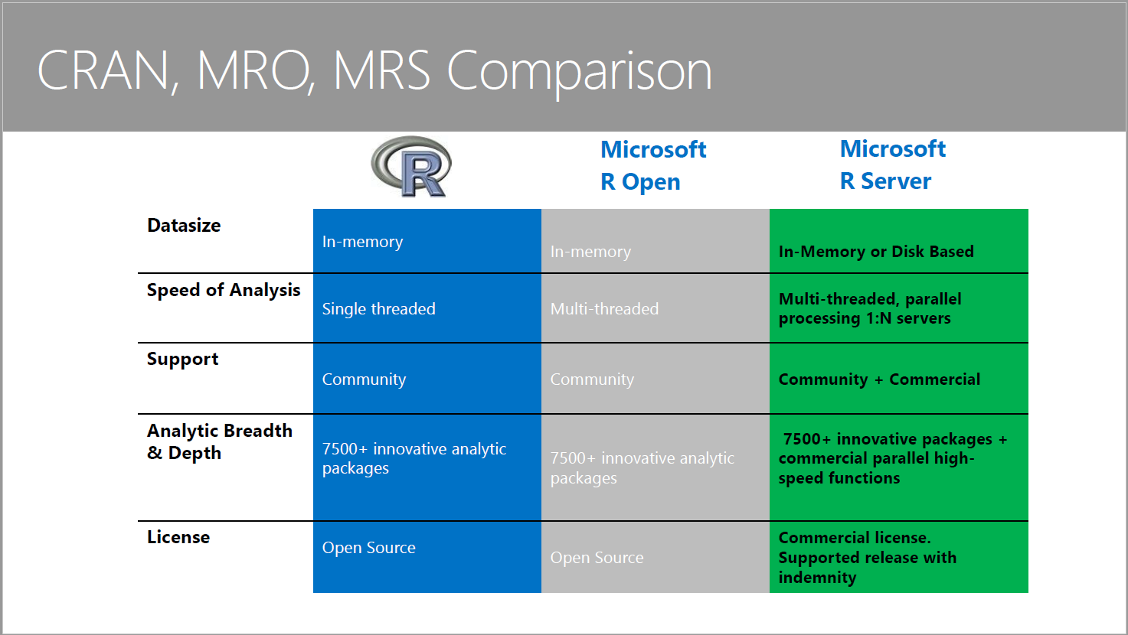


Microsoft R Product Family
Notes:
Microsoft R Client
Microsoft R Client is a free, community-supported, data science tool for high performance analytics. R Client is built on top of Microsoft R Open so you can use any open source R packages to build your analytics. Additionally, R Client introduces the powerful ScaleR technology and its proprietary functions to benefit from parallelization and remote computing.
R Client allows you to work with production data locally using the full set of ScaleR functions, but there are some constraints. On its own, the data to be processed must fit in local memory, and processing is limited up to two threads for ScaleR functions. To benefit from disk scalability, performance and speed, you can push the compute context to a production instance of Microsoft R Server such as SQL Server R Services and R Server for Hadoop.
----------
Revolution took the R language, which was a client-side, memory-bound technology, and it made it server-based and multi-threaded. As a second act, Revolution built a distributed version of the product that could run in clustered/grid environments, so it could take on Big Data workloads and avoid sampling.
Finally, in order to combat the inefficiencies (and occasional non-feasibility) of moving data to R (on the client or server) from its origin, Revolution created integrated versions of its server product, for Hadoop and various data warehouse platforms.
http://www.zdnet.com/article/microsofts-r-strategy/

Slide 15
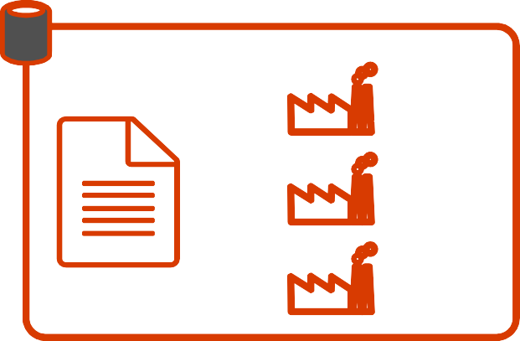

Escapes R’s traditional memory limits
Scales predictive modeling using parallelization
Distributes computation cores & nodes
Minimizes data movement using in- database, in-MapReduce and in-Apache Spark execution

Slide 16
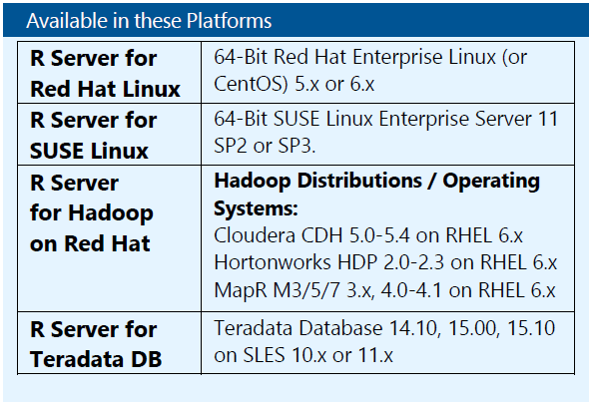
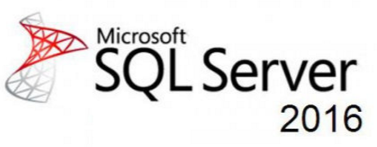






Microsoft R: Write Once, Deploy Anywhere

Slide 17











Cloud
Hadoop & Spark
R Server portfolio
R Server Technology
EDW
RDBMS
Desktops & Servers
Write Once – Deploy Anywhere

Slide 18
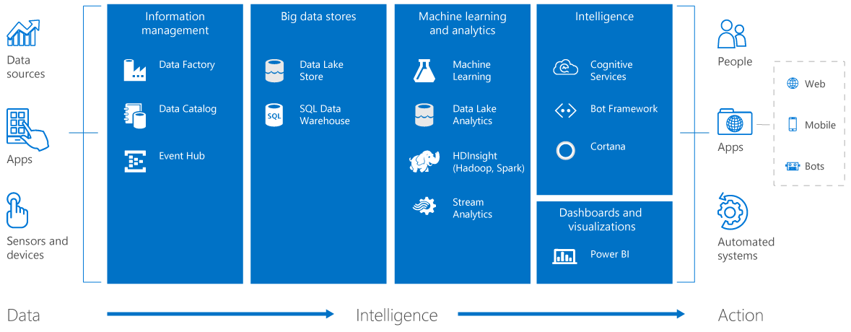
Deployment Environments (Contexts)
Cloud
On-Premises
Cortana Intelligence Suite
A suite of products that allow you to Predict Outcomes, Prescribe Actions and Automate Decisions for Operationalized Solutions

Slide 20



Slide 22

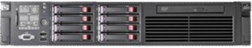
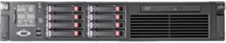
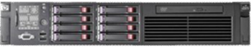

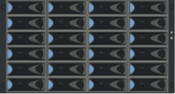






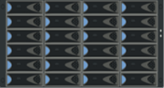





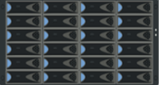




Distributed R - How Does Remote Compute Context ?
Microsoft R Server “Client”
Microsoft R Server “Server”
Analyze Blocks In Parallel
Load Block At A Time
Big Data
R IDE or command- line
Distribute Work, Compile Results
REMOTE CONTEXT
Algorithm Master
Predictive Algorithm
Results
“Pack and Ship” Requests to Remote Environments
Console
Microsoft R Server functions
A compute context defines where to process.
E.g. remote context like Hadoop Map Reduce
Microsoft R functions prefixed with rx
Current set compute context determines processing location
Copyright Microsoft Corporation. All rights reserved.

Slide 23




Slide 24
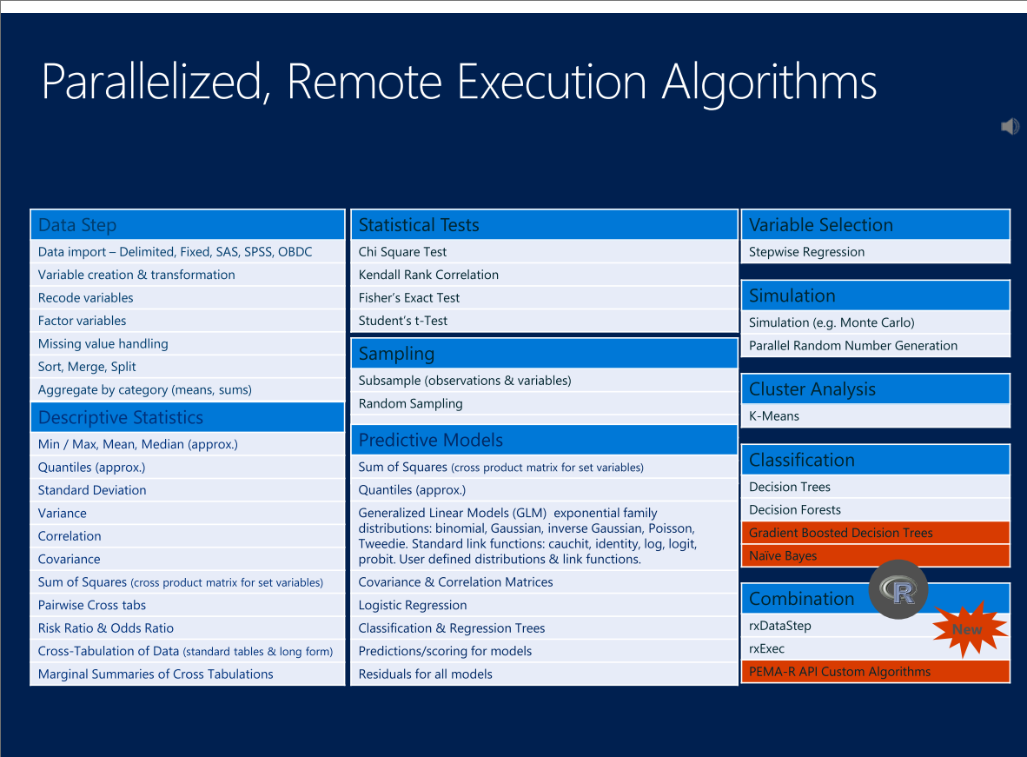

Slide 25
Demonstration

Slide 26

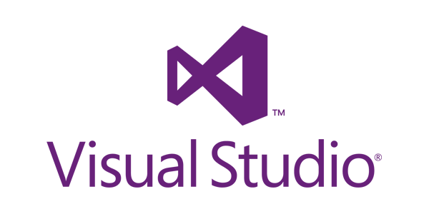
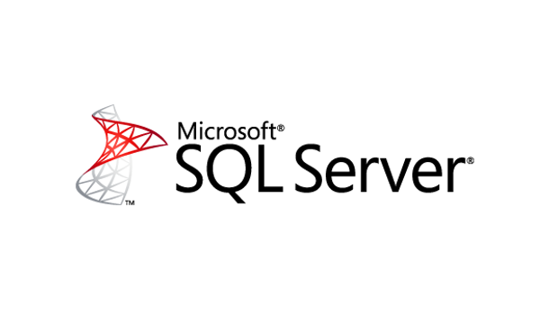
SQL Server R Services
Development
Deployment
Data scientists / analysts work in existing development environment
Use optimized RevoScaleR functions (available with Microsoft R Client)
Compute in-database
instead of using local resources
Enhance SQL data with R features
Embed R code in
SQL stored procedures
Send SQL input
Receive dataset, model, or plot output
Consume in applications
or other client tools
Notes:
At this point, we’ll move on to SQL Server R Services. Essentially, R Services is R Server simply packaged with SQL Server 2016. There are a few advantages of bundling R with SQL Server, both from the development side as well as putting R code into production use. For data scientists or other advanced analytics practitioners who are already writing R, you don’t need to change much about your environment. If you work in RStudio, the new R Tools for Visual Studio, or any other R IDE, you can stay in your familiar environment. By installing the Microsoft R Client, however, you can optimize your existing code with the help of the ScaleR functions available from the RevoScaleR package. Think of the recently released R Client as R Open, but the primary difference is that it includes these ScaleR functions. The ScaleR functions are optimized for parallel threads and in-memory execution, and they have a broad range from input/output to data transformation to statistics and advanced modeling. Another advantage of working with ScaleR is that you can write all of your code locally, but instead of importing the data into your local environment and facing possible resource constraints there, you can change your compute context so that you are working from SQL Server in-database. If you commonly get data from packages such as RSqlServer or RODBC, you’ll no longer have to import in that manner.
In terms of deployment, R Services alleviates some common burdens associated with pushing R code to production. What Microsoft has done is allow you to embed your R code within the body of a SQL stored procedure. SQL Server is already optimized for production-level workloads, governance, and availability. By embedding within SQL Server, you use standard SQL to take advantage of your R code. Applications and other client tools access the stored procedure using SQL, and SQL is returned as output. It’s transparent to the user or application. They don’t need to know what the R code is doing or even that it is there, but they can consume it nonetheless.
----------------------
The integration of R in SQL Server is clever, if a little bit Rube Goldberg. Data professionals and analysts comfortable working with R from their workstations can do so, and yet they can still delegate the actual compute work to happen on the SQL Server. By using a set of R functions provided by Revolution, and which emulate a set of standard R functions, R pros can set the "compute context" to SQL Server in their R scripts. Then everything executes remotely.
In addition, code in SQL Server's native language, Transact SQL (T-SQL), can run in a "polyglot" fashion whereby R code is embedded inside it. Unfortunately T-SQL sees the R code as a simple text string, which it sends to a special system stored procedure for execution. That means the R code is not color syntax highlighted or checked before execution. Developers are well-advised to test their R code in a client tool first, and then bring it to SQL Server.
http://www.zdnet.com/article/microsofts-r-strategy/
---------------------------------

Slide 27
SQL Server R Services
Development
Deployment
sql <- RxInSqlServer([SQL connection])
rxSetComputeContext(sql)
[…]
I/O → RxSqlServerData(), etc.
Stats → rxSummary(), etc.
Models → rxLogit(), etc.
Plots → rxRocCurve(), etc.
EXEC sp_execute_external_script
@language = N’R’,
@script = N’[R code goes here]’,
@input_data_1 = N’[SQL input]’
[ , @input_data_1_name = N‘InputDataSet’ ]
[ , @output_data_1_name = N’OutputDataSet’ ]
[ , @params = N’parameter’ ]
WITH RESULT SETS (([SQL output]));
Notes:
Taking a quick look at what the two scenarios might be, you can see on the left that an R developer working in RStudio or Visual Studio writes some R code. The sample on the top shows partial syntax for working with SQL data by changing your compute context from local to SQL. The rest simply outline a few of the ScaleR functions, and you can see that they touch areas such as input/output, statistical modeling, and some common plots.
On the right, you can see how R can be embedded in a stored procedure for general operation and deployment. Anyone working in SQL Server Management Studio, for example, can adapt existing R code for use in SQL Server. The “sp_execute_external_script” procedure takes SQL input, runs the R script, and provides SQL output. From the perspective of a user, it’s like calling any other stored procedure.

Slide 28








R Server for HDInsight
Bring your compute to the data in the data lake,
not the other way around!
HDInsight with R Server
Machine Learning on Terabytes of Data
Use familiar IDEs like R Studio
No Hadoop experience? No Problem!

Slide 29

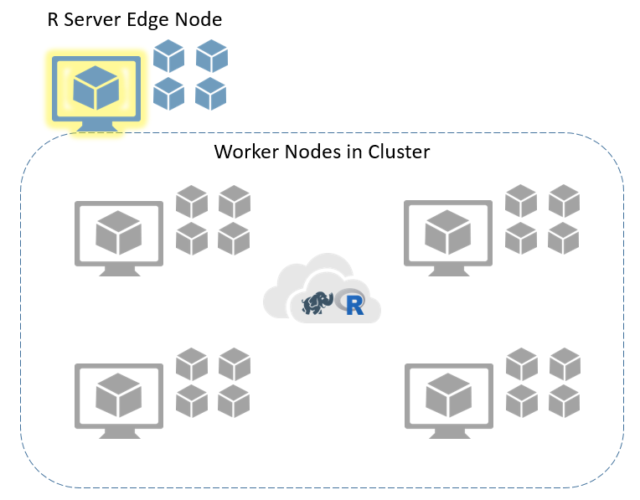
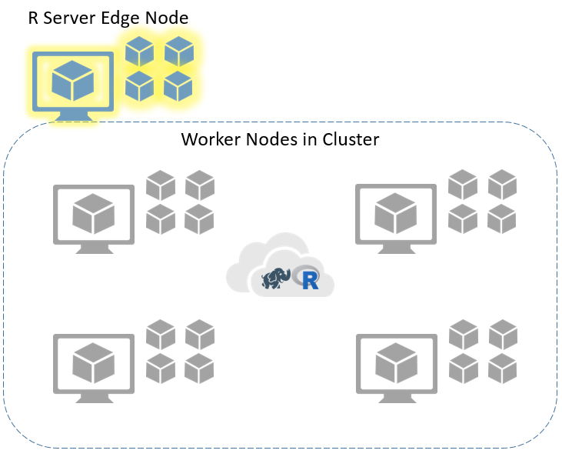
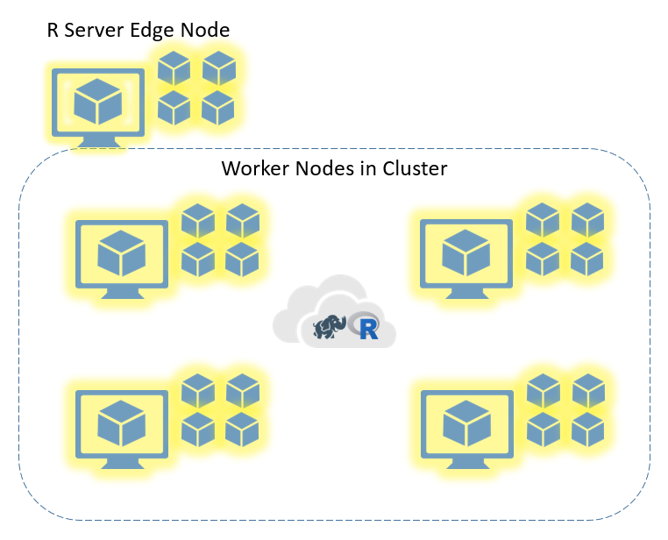
Execution Contexts in HDInsight with R Server
Execute Code
Execute Code
Execute Code
Local
Local Parallel
MapReduce or Spark

Slide 30
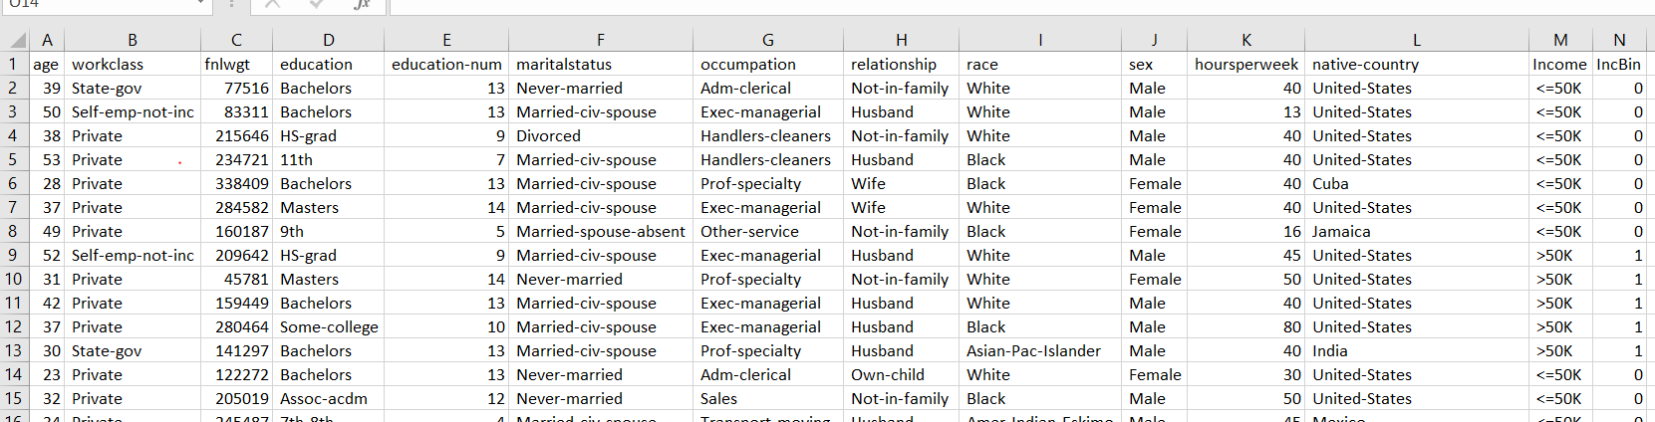

Quick HDInsight with R Server Example
/data/income/income.csv

Slide 31
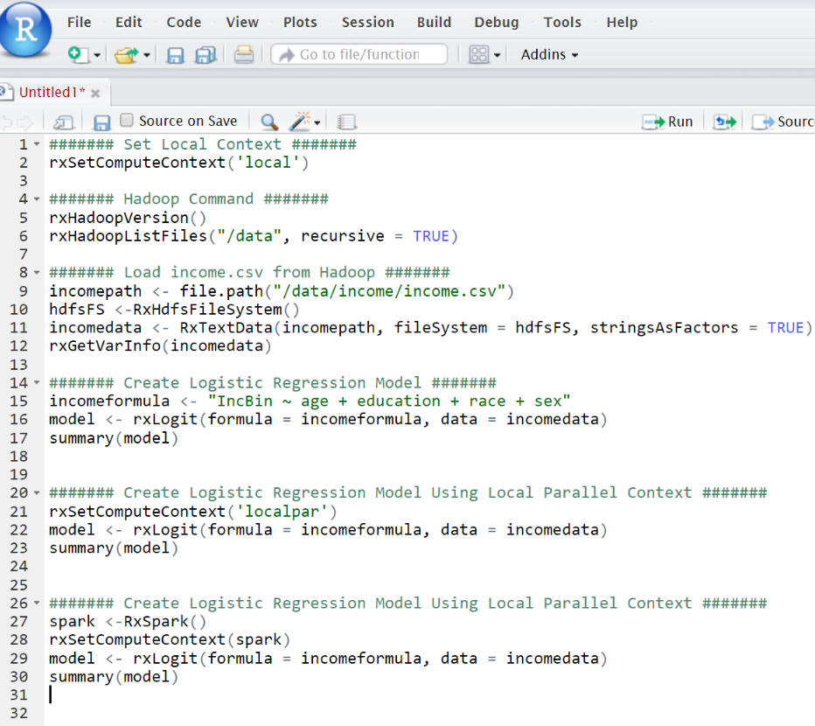
Quick HDInsight with R Server Example
Set the compute context to ‘local’.
Check Hadoop version and explore
the “data” folder in HDFS.
Define path to income.csv file, create a data source using the path specifying the HDFS file system, and view the variables for the data source.
Create a Logistic Regression model for the binary income variable using age, education, race, and sex as features.
Change the compute context to ‘localpar’ and create the same Logistic Regression model
Change the compute context to RxSpark() and create the same Logistic Regression model

Slide 32
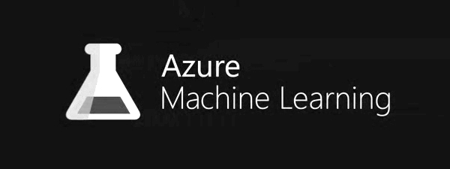
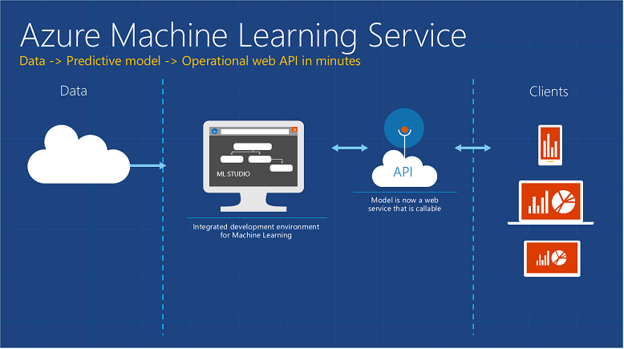

Azure Machine Learning
Azure ML: Features
A fully managed cloud service that enables you to easily build, deploy, and share predictive analytics solutions
ML Studio enables you to build an end-to-end, data science workflow in the form of an experiment
Drag-and-drop predictive modeling
Large library of modules to develop custom solutions
Use existing R code with minimal modifications
ML API service enables you to deploy predictive models as scalable web services
Cloud
Local

Slide 33
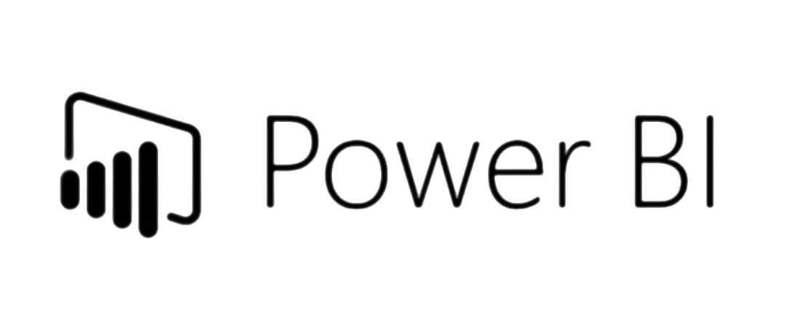
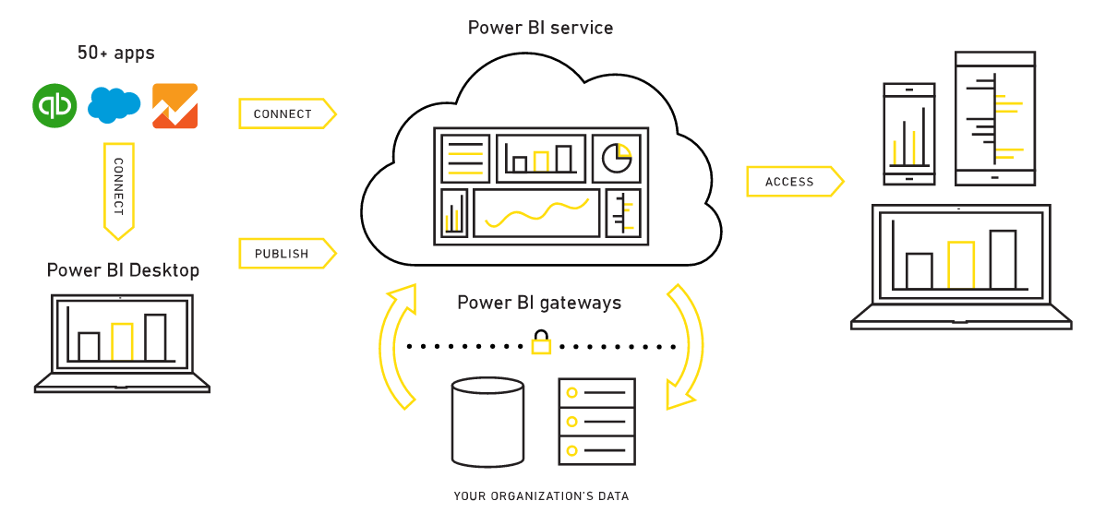
Power BI
A suite of business analytics tools to analyze data and share insights
Power BI: Features
Display interactive reports across the whole organization
Connect to 50+ data sources
Including: Azure, Excel, GitHub, Visual Studio Online
Rich visualization capability, including R graphics
Power BI Mobile apps
Power BI Desktop / Web

Slide 34



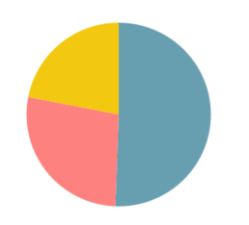
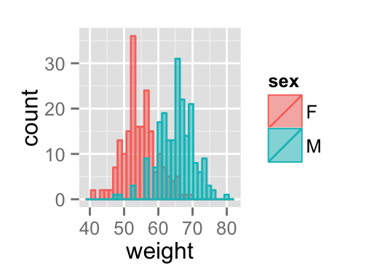

R in Power BI
Use an R Script to Create a Visualization
Use an R Script
as a Data Source

Slide 35
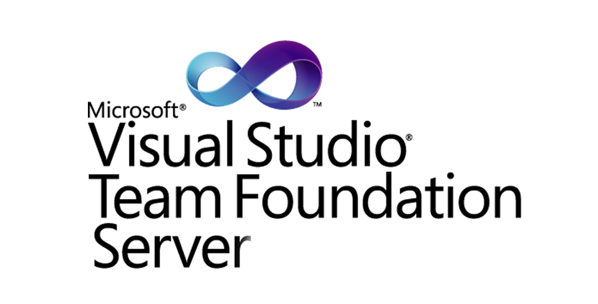



Project Management and Analytics Governance
Source control, reporting, and project management capabilities
Share code, track work, and ship software
Distributed version control system
Hosted public and private repositories; integrated with Visual Studio

Slide 36
Review of Benefits
Analytics Director/VP
Better analytics governance and collaboration via centralized model and project management (AzureML, TFS, VSO, Jupyter)
Broaden the reach of enterprise analytics
IT Director/CIO
Streamlined workflow: avoid re-engineering
High-performance processing on high-value data
Align IT and data science development
Integrate Microsoft data platform with advanced analytics
Reduced data movement = higher performance and security
Data Scientist
Better tools = more opportunities
Spend less time on data management – run your models where the data resides
Take an active role in operationalizing analytics
Cool tech! Expand knowledge to cloud, Big Data, and modern data platform

Slide 37
Getting Started

Slide 38
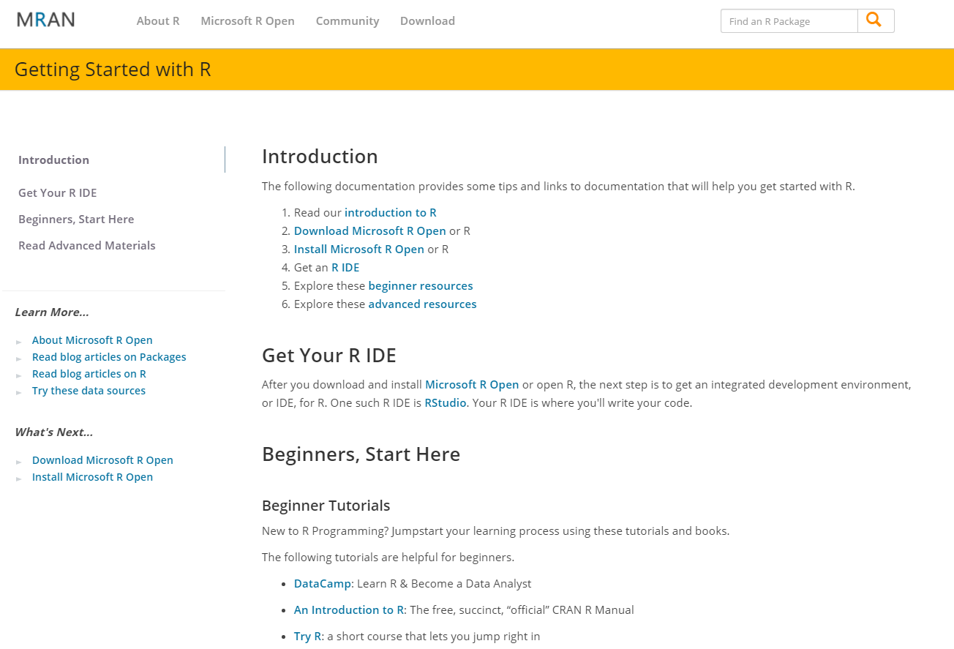
Getting Started
https://mran.revolutionanalytics.com/documents/getting-started/

Slide 39
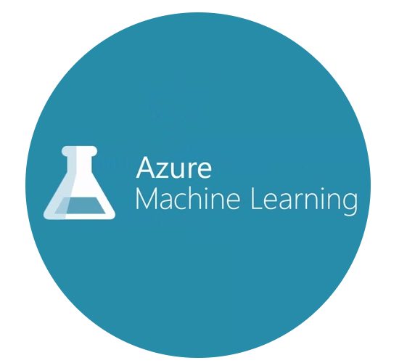

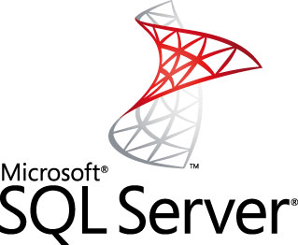

MICROSOFT AZURE: Getting Started
DATA SCIENCE
virtual machine
Easily build, deploy and share predictive analytics solutions
$200
Azure credit on sign-up
Create and share documents that contain live code, visualizations, and explanatory text

Slide 40
Additional Information

Slide 41
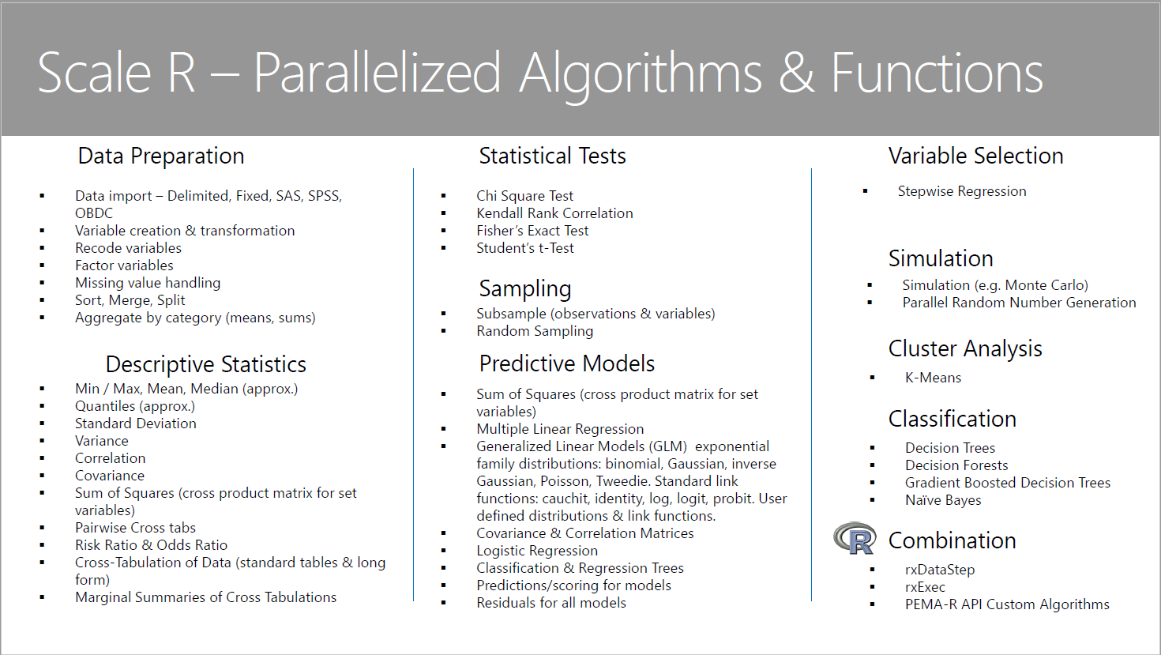
Microsoft R Parallelized Algorithms and Functions

Slide 42
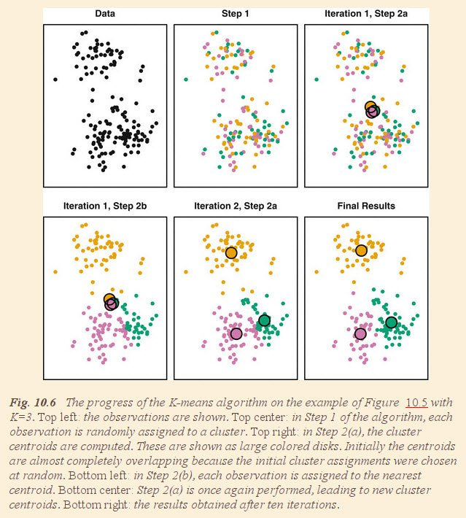
Example of machine learning algorithm (clustering)

